Slide 1

MiniProject #2
Enterprise Integration Patterns

Slide 2
Business Case
A User want to rent a car of type x at a specific date.
He will then see all the available cars.
Choose a color if there’s multiple.
And lastly give a name and driverlicens to make the booking

Slide 3
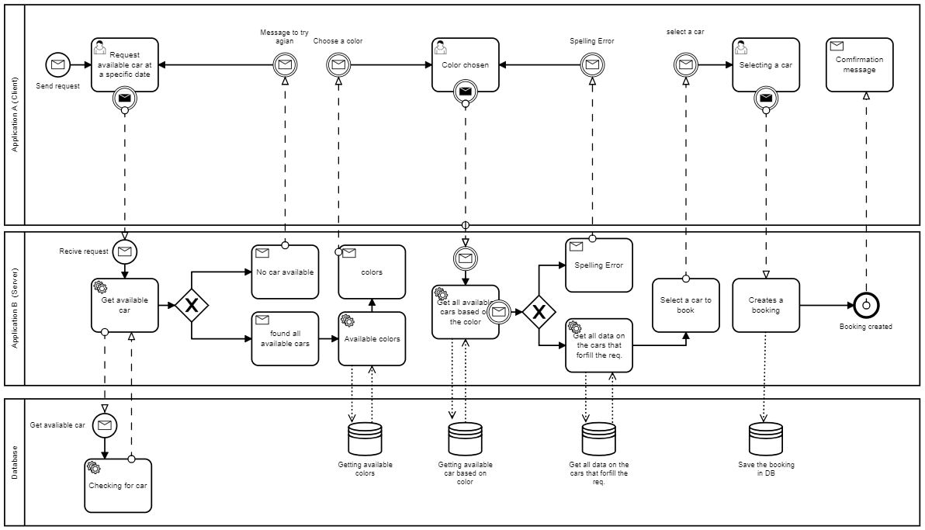
BPMN
Here is a visualization of the business process.

Slide 4
Enterprise Integration Pattern used
Massage → Is what we’re sending over the channel. From the client to the server and back agian.
Massage Channel → A channel that allow os to send messages from A to B.
Splitter → Enable us to split a message into usefull sub messeage that can be used in the server logic.
Aggregator → collect different messages and then all are collected, sends back a aggregated message.
Request – Reply → we send a request from client and the server then must give a response back.
Massage Broker → allow easly route, channel and queues (Mqrabbit was easy to setup)

Slide 5
enough talking – Lets see it in action!

